Slide 1
Lecture 18&19
Software Testing
BSCS (Software Engineering-I) SZABIST-Islamabad

Slide 2
Software Testing
Testing is the process of evaluating a system or its component(s) with the intent to find whether it satisfies the specified requirements or not.
Testing is executing a system in order to identify any gaps, errors, or missing requirements in contrary to the actual requirements.
BSCS (Software Engineering-I) SZABIST-Islamabad

Slide 3
Purpose of Software Testing
To
  To find if it satisfy requirements
  Identify Gaps
  Identify Errors
  Identify Missing requirements
BSCS (Software Engineering-I) SZABIST-Islamabad

Slide 4

Defect
Defect: A flaw in a component or system that can cause the component or system to fail to perform its required function, e.g. an incorrect statement or data definition. A defect, if encountered during execution, may cause a failure of the component or system.
BSCS (Software Engineering-I) SZABIST-Islamabad

Slide 5
Defect Density
Defect Density: The number of defects identified in a system divided by the size of the system (expressed in standard measurement terms, e.g. lines-of-code, number of classes or function points).
Example: Let suppose we have web app with size of 2000 lines of code. And while testing we have identified 200 defects in it. So, defect density will be
200 = 1/10 = 0.5
2000
BSCS (Software Engineering-I) SZABIST-Islamabad

Slide 6
Defect Management
Defect Management: The process of recognizing, investigating, taking action and disposing of defects. It involves recording defects, classifying them and identifying the impact.
Steps:
  Recognizing (Recording)
  Investigating(classifying and identifying impacts)
  Taking action
  Disposing
BSCS (Software Engineering-I) SZABIST-Islamabad

Slide 7
Defect Life cycle
Defect life cycle, also known as Bug Life cycle is the journey of a defect cycle, which a defect goes through during its lifetime. It varies from organization to organization and also from project to project as it is governed by the software testing process and also depends upon the tools used.
BSCS (Software Engineering-I) SZABIST-Islamabad

Slide 8
Defect Life Cycle States
New - Potential defect that is raised and yet to be validated.
Assigned - Assigned against a development team to address it but not yet resolved.
Active - The Defect is being addressed by the developer and investigation is under progress. At this stage there following possible outcomes; Test, Deferred or Rejected.
Test - The Defect is fixed and ready for testing.
Verified - The Defect that is retested and the test has been verified by QA.
Closed - The final state of the defect that can be closed after the QA retesting or can be closed if the defect is duplicate or considered as NOT a defect.
Reopened - When the defect is NOT fixed, QA reopens/reactivates the defect.
Deferred - When a defect cannot be addressed in that particular cycle it is deferred to future release.
Rejected - A defect can be rejected for any of the following reasons; duplicate defect, NOT a Defect.
BSCS (Software Engineering-I) SZABIST-Islamabad

Slide 9
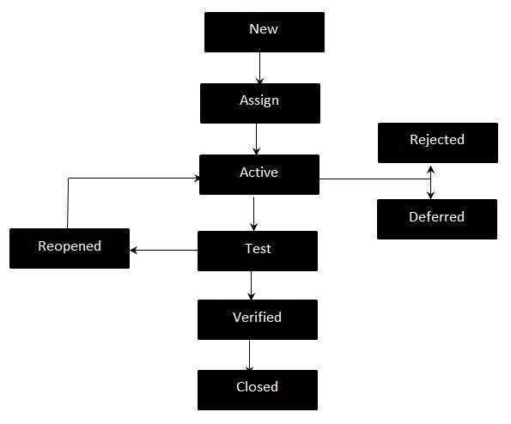
Defect Life cycle
BSCS (Software Engineering-I) SZABIST-Islamabad

Slide 10
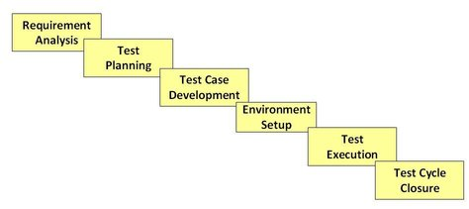
Software Testing Life Cycle
Software Testing Life Cycle (STLC) is defined as a sequence of activities conducted to perform Software Testing.
It consists of series of activities carried out methodologically to help certify your software product.
BSCS (Software Engineering-I) SZABIST-Islamabad

Slide 11
(1) Requirement Analysis
During this phase, test team studies the requirements from a testing point of view to identify the testable requirements.
Requirements could be either Functional (defining what the software must do) or Non Functional (defining system performance /security availability )
The QA team may interact with various stakeholders (Client, Business Analyst, Technical Leads, System Architects etc.) to understand the requirements in detail.
Automation feasibility for the given testing project is also done in this stage.
Activities
Identify types of tests to be performed.
Gather details about testing priorities and focus.
Prepare Requirement Traceability Matrix (RTM).
Identify test environment details where testing is supposed to be carried out.
Automation feasibility analysis (if required).
Deliverables
RTM
Automation feasibility report. (if applicable)
BSCS (Software Engineering-I) SZABIST-Islamabad

Slide 12
Software Testing Terminologies
Metric: A measurement scale and the method used for measurement.
Traceability: The ability to identify related items in documentation and software, such as requirements with associated tests. (horizontal traceability, vertical traceability).
Requirement Traceability Metric(RTM): is a document used to ensure that the requirements defined for a system are linked at every point during the verification process. It also ensures that they are duly tested with respect to test parameters and protocols.
Automation feasibility report: is a document which tells which of the part of testing could be automated and which is not possible to automate.
BSCS (Software Engineering-I) SZABIST-Islamabad

Slide 13
(2) Test Planning
In this stage, a Senior QA manager will determine effort and cost estimates for the project and would prepare and finalize the Test Plan. In this phase, Test Strategy is also determined.
Activities
Preparation of test plan/strategy document for various types of testing
Test tool selection
Test effort estimation
Resource planning and determining roles and responsibilities.
Training requirement
Deliverables
Test plan /strategy document.
Effort estimation document.
BSCS (Software Engineering-I) SZABIST-Islamabad

Slide 14
Test Plan Document
Introduction
Scope Headings/Test Items
  Features to be Tested
  Features not to be Tested
UAT Approach
  Develop Tests
  Testing Entry Criteria
Ending Testing
  Item Pass/Fail Criteria
  Evaluation Team
  Exit Criteria
  Evaluation Process
  Requirements Traceability Matrix
Suspension Criteria
This deals with when you suspend and restart testing and is a RISK section .
Testing Deliverables
Testing produces a lot of data and this section tells what the are. These are a QUALITY item.
  Test Deliverables
BSCS (Software Engineering-I) SZABIST-Islamabad

Slide 15
Software Testing Terminologies
Test Plan Document: A document describing the scope, approach, resources and schedule of intended test activities. It identifies amongst others test items, the features to be tested, the testing tasks, who will do each task, degree of tester independence, the test environment, the test design techniques and entry and exit criteria to be used, and the rationale for their choice, and any risks requiring contingency planning. It is a record of the test planning process.
Test Evaluation Report: A document produced at the end of the test process summarizing all testing activities and results. It also contains an evaluation of the test process and lessons learned.
Effort Estimation Documentation: A document that tells how much efforts required to perform testing for each module.
BSCS (Software Engineering-I) SZABIST-Islamabad

Slide 16
(3) Test Case Development
This phase involves creation, verification and rework of test cases & test scripts. Test data is identified/created and is reviewed and then reworked as well.
Activities
Create test cases, automation scripts (if applicable)
Review and baseline test cases and scripts
Create test data (If Test Environment is available)
Deliverables
Test cases/scripts
Test data
BSCS (Software Engineering-I) SZABIST-Islamabad

Slide 17
Test case example for Login
Test case ID | Testcase Description | Expected Results | Actual Results | Status
1 | Login with correct ID & Password | It allow to login
2 | Login with invalid ID & correct password | It shouldn't allow to login
3 | Login with correct Id and invalid password | It shouldn’t allow to login
4 | Login with Blank ID and correct password | It shouldn’t allow to login
5 | Login with correct ID and Blank Password | It shouldn’t allow to login
6 | Login with Blank ID and Password | It shouldn’t allow to login
BSCS (Software Engineering-I) SZABIST-Islamabad

Slide 18
Software Testing Terminologies
Test Case: A set of input values, execution preconditions, expected results and execution post conditions, developed for a particular objective or test condition, such as to exercise a particular program path or to verify compliance with a specific requirement.
Test Suite: A set of several test cases for a component or system under test, where the post condition of one test is often used as the precondition for the next one.
Test Case Specification: A document specifying a set of test cases (objective, inputs, test actions, expected results, and execution preconditions) for a test item.
Test Data: Data required to perform testing. Could be actual or dummy. In real organization data is taken from PROD (Production) environment.
BSCS (Software Engineering-I) SZABIST-Islamabad

Slide 19
Test Case Specification
IDENTIFIER | TC_001
DESCRIPTION | Login with correct values
PRECONDITION | Login screen available
STEPS | TECHNIQUE | PROCEDURE | EXPRECTED RESULTS
1 | Manual | Enter user id in the user id box | It should allow to enter
2 | Manual | Enter password in the password box | It should allow to enter
3 | Manual | Press Sign in Button | It should allow to press and login successfully
BSCS (Software Engineering-I) SZABIST-Islamabad

Slide 20
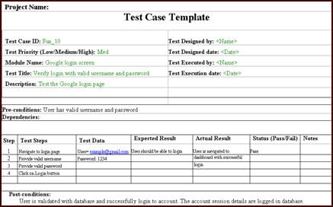
Test Case Specification
BSCS (Software Engineering-I) SZABIST-Islamabad

Slide 21
(4) Test Environment Setup
Test environment decides the software and hardware conditions under which a work product is tested. Test environment set-up is one of the critical aspects of testing process and can be done in parallel with Test Case Development Stage. Test team may not be involved in this activity if the customer/development team provides the test environment in which case the test team is required to do a readiness check (smoke testing) of the given environment.
Activities
Understand the required architecture, environment set-up and prepare hardware and software requirement list for the Test Environment.
Setup test Environment and test data
Perform smoke test on the build
Deliverables
Environment ready with test data set up
Smoke Test Results.
BSCS (Software Engineering-I) SZABIST-Islamabad

Slide 22
Software Testing Terminologies
Test Environment: An environment containing hardware, instrumentation, simulators, software tools, and other support elements needed to conduct a test.
Smoke Test: A special type of testing performed to make sure if the test environment is ready or not.
BSCS (Software Engineering-I) SZABIST-Islamabad

Slide 23
(5) Test Execution
During this phase the testers will carry out the testing based on the test plans and the test cases prepared. Bugs will be reported back to the development team for correction and retesting will be performed.
Activities
Execute tests as per plan
Document test results, and log defects for failed cases
Map defects to test cases in RTM
Retest the Defect fixes
Track the defects to closure
Deliverables
Completed RTM with execution status
Test cases updated with results
Defect reports
BSCS (Software Engineering-I) SZABIST-Islamabad

Slide 24
(6) Test Cycle Closure
Testing team will meet , discuss and analyze testing artifacts to identify strategies that have to be implemented in future, taking lessons from the current test cycle. The idea is to remove the process bottlenecks for future test cycles and share best practices for any similar projects in future.
Activities
Evaluate cycle completion criteria based on Time, Test coverage, Cost, Software, Critical Business Objectives , Quality
Prepare test metrics based on the above parameters.
Document the learning out of the project
Prepare Test closure report
Qualitative and quantitative reporting of quality of the work product to the customer.
Test result analysis to find out the defect distribution by type and severity.
Deliverables
Test Closure report
Test metrics
BSCS (Software Engineering-I) SZABIST-Islamabad

Slide 25
Software Testing Terminologies
Entry Criteria: The set of generic and specific conditions for permitting a process to go forward with a defined task, e.g. test phase. The purpose of entry criteria is to prevent a task from starting which would entail more (wasted) effort compared to the effort needed to remove the failed entry criteria.
“Test Entry Criteria gives the prerequisite items that must be completed before testing can begin.”
An approved testing plan.
  A testing plan needs to be developed in advance of the start of testing, and crucially agreed to by all the stakeholders. These include the testing, user, and development teams. This way the testing risk is known and shared.
All resources available.
  People assigned and properly trained in the software system and testing skills.
  A hardware and software testing environment has been set up to allow testing against a separate version of the system.
  Software and paperwork set up to allow proper recording of the testing process.
  Test data has been designed and set up on the test system.
All tests developed.
  All the acceptance criteria, test cases, and test scripts need to have been developed and signed off by key stakeholders before the testing runs start.
BSCS (Software Engineering-I) SZABIST-Islamabad

Slide 26
Software Testing Terminologies
Exit Criteria: The set of generic and specific conditions, agreed upon with the stakeholders, for permitting a process to be officially completed. The purpose of exit criteria is to prevent a task from being considered completed when there are still outstanding parts of the task which have not been finished. Exit criteria are used to report against and to plan when to stop testing.
“Test Exit Criteria defines the items that must be completed before testing can be concluded”
Main functionality available.
Important faults cleared.
Other faults recorded.
Documentation updated.
Test Summary Report produced.
BSCS (Software Engineering-I) SZABIST-Islamabad

Slide 27
Software Testing Terminologies
Expected Result: The behavior predicted by the specification, or another source, of the component or system under specified conditions.
Actual Result: It is the result that you get after executing a test.
Acceptance Criteria: The exit criteria that a component or system must satisfy in order to be accepted by a user, customer or other authorized entity.
BSCS (Software Engineering-I) SZABIST-Islamabad

Slide 28
Software Testing Terminologies
Pass: A test is deemed to pass if its actual result matches its expected result.
Fail: A test is deemed to fail if its actual result does not match its expected result.
Pass/Fail Criteria: Decision rules used to determine whether a test item (function) or feature has passed or failed a test.
False-Positive Result: A test result in which a defect is reported although no such defect actually exists in the test object.
False-Negative Result: A test result which fails to identify the presence of a defect that is actually present in the test object.
BSCS (Software Engineering-I) SZABIST-Islamabad

Slide 29
Software Testing Terminologies
False-Positive Result
Test Fail
Report
No exist
False-Negative Result:
Test Pass
Not Report
Exist
BSCS (Software Engineering-I) SZABIST-Islamabad

Slide 30
Software Testing Terminologies
Boundary Value: An input value or output value which is on the edge of an equivalence partition or at the smallest incremental distance on either side of an edge, for example the minimum or maximum value of a range.
Coverage Analysis: Measurement of achieved coverage to a specified coverage item during test execution referring to predetermined criteria to determine whether additional testing is required and if so, which test cases are needed.
BSCS (Software Engineering-I) SZABIST-Islamabad

Slide 31
Software Testing Terminologies
Testability: The capability of the software product to enable modified software to be tested.
Re-testing: Testing that runs test cases that failed the last time they were run, in order to verify the success of corrective actions.
BSCS (Software Engineering-I) SZABIST-Islamabad

Slide 32
Software Testing Terminologies
Test Execution: The process of running a test on the component or system under test, producing actual result(s).
Test Automation: The use of software to perform or support test activities, e.g. test management, test design, test execution and results checking.
Test Execution Automation: The use of software, e.g. capture/playback tools, to control the execution of tests, the comparison of actual results to expected results, the setting up of test preconditions, and other test control and reporting functions.
BSCS (Software Engineering-I) SZABIST-Islamabad

Slide 33
Software Testing Terminologies
Mean Time Between Failures: is average amount of time that a product functions before failing. The MTBF is typically part of a reliability growth model that assumes the failed system is immediately repaired, as a part of a defect fixing process.
Fault Tolerance: The capability of the software product to maintain a specified level of performance in cases of software faults (defects) or of infringement of its specified interface.
BSCS (Software Engineering-I) SZABIST-Islamabad

